Slide 1
Peripheral cards and devices
Peripheral card

Slide 2
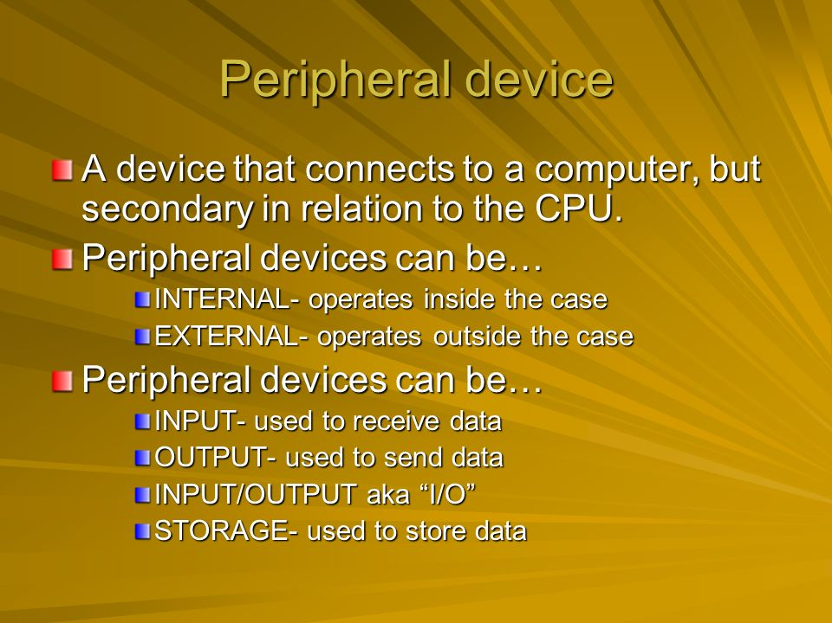
Peripheral Devices Introduction

Slide 3
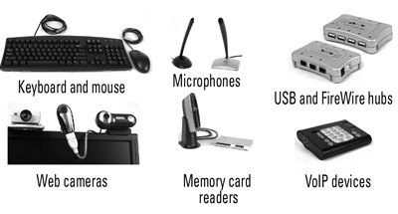
Peripheral Devices Introduction

Slide 4
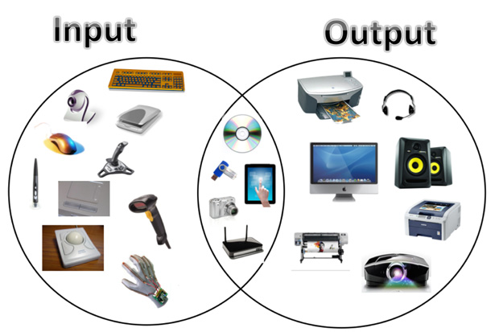
Peripheral Devices Introduction

Slide 5
Peripheral Cards Introduction
In computing, an expansion card (also called an expansion board, adapter card, peripheral card or accessory card) is a printed circuit board that can be inserted into an electrical connector, or expansion slot (also referred to as a bus slot) on a computer's motherboard (see also backplane) to add functionality to a computer system.

Slide 6
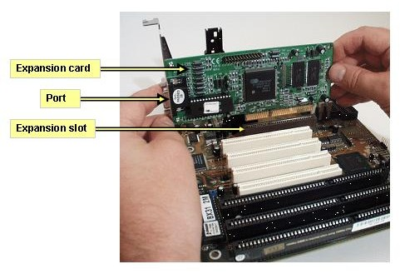
Peripheral Cards Introduction

Slide 7
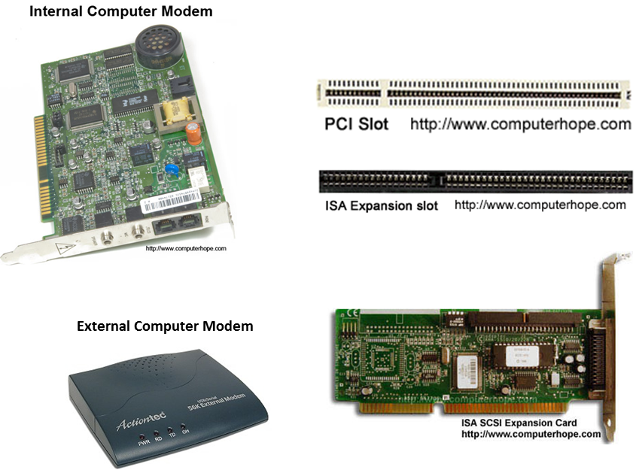
Peripheral Cards Introduction

Slide 8
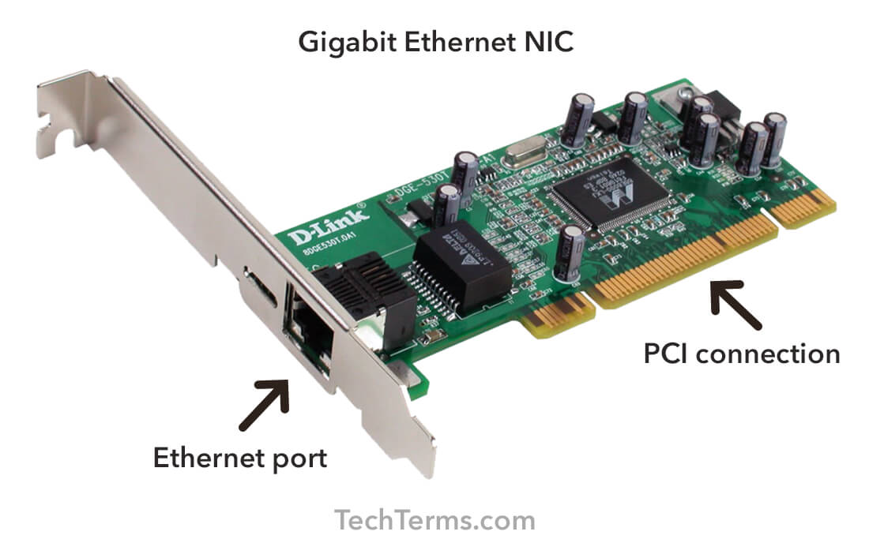
Network card

Slide 9
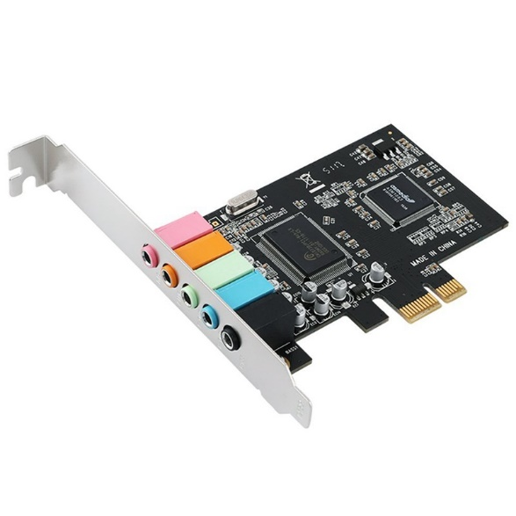
Sound card

Slide 10
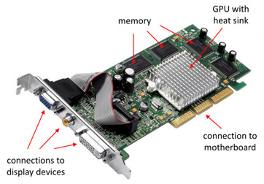
Video card

Slide 11
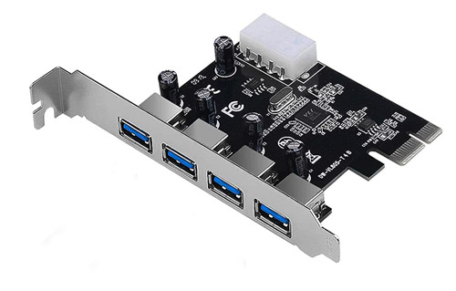
USB card

Slide 12
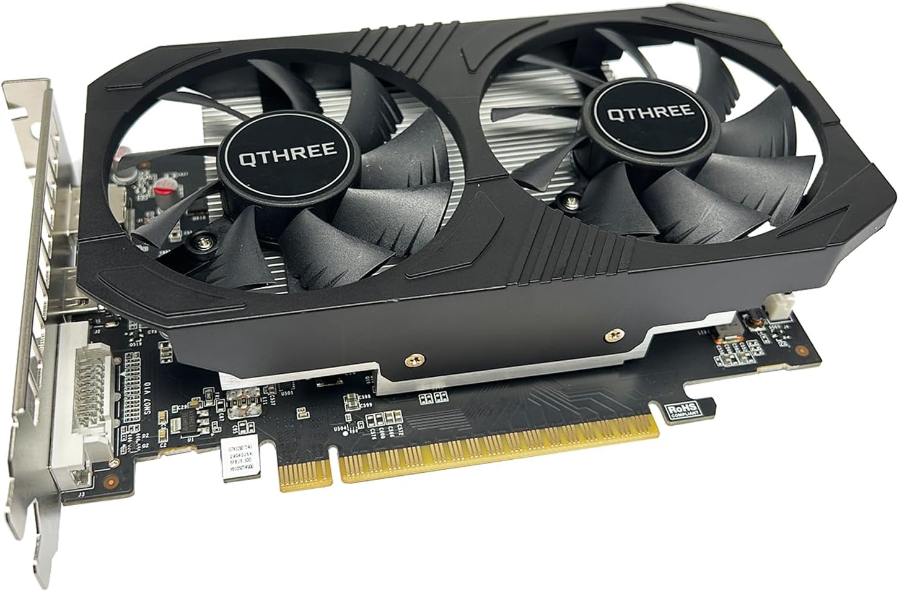
Graphics card

Slide 13
Thank You

